Slide 1

Algorithmic SDN Programming: Toward High-Level, Datapath Oblivious SDN Programming
Y. Richard Yang
Dec. 3, 2015
Notes:
What does it mean to say software-driven? For large network equipment vendors, software cost already accounts for 90% of R&D cost.

Slide 2
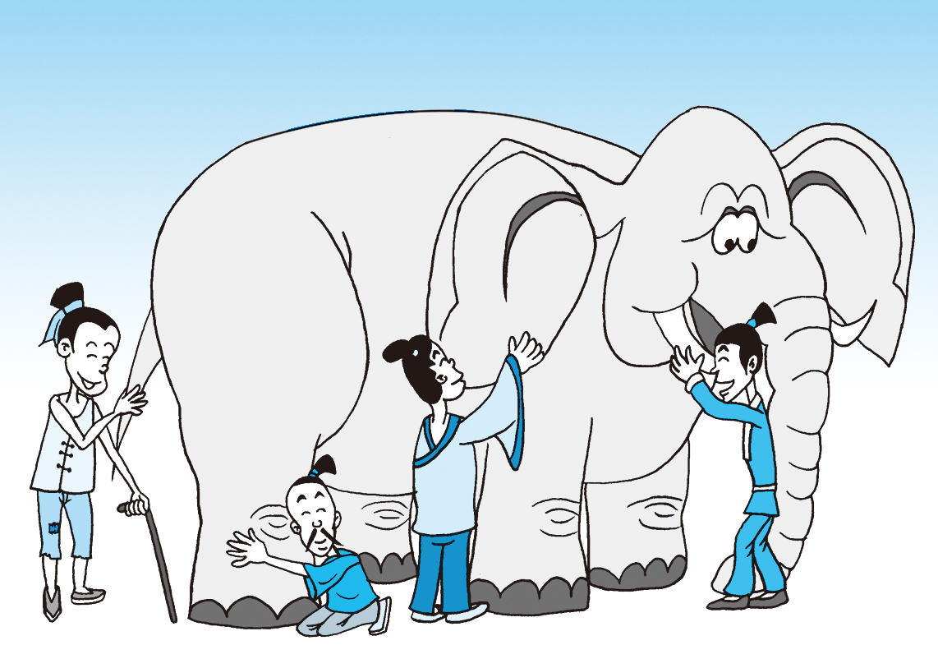
What is SDN?
Notes:
At a high level, abstraction is to hide issues that others do not want to or hard to do things.

Slide 3

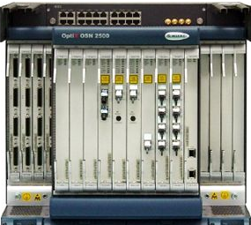
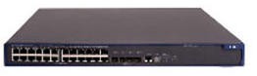
What is SDN: a “Main-Stream” View
Separation of data and control paths, with a logically centralized control plan
Traditional
SDN
Control
Control
standard control
protocol
Datapath
Datapath
Control
Datapath
Datapath
Control
Datapath
Datapath
Notes:
FLP, Arrow’s Impossibility Theorem. Failure of distributed computing.

Slide 4
An Evolution View of Intradomain Routing Toward SDN
Link State
Distance Vector
SDN
Control
Logically Central Link State
notification/
management/ control
protocol
Dijkstra
Distributed Bellman Ford
Distributed Link State
Dijkstra
Datapath
Distributed Bellman Ford
Distributed Link State
Dijkstra
Datapath
Distributed Bellman Ford
Distributed Link State
Datapath
Notes:
RIP: 1988 RFC1058 RFC2328

Slide 5
Why SDN (A “Defeatist” View)?
Distributed computing is hard, e.g.,
FLP Impossibility Theorem
Arrow’s Impossibility Theorem
Achieved good design for only some specific tasks (e.g., state distribution, leader election). Hence, one can consider SDN as a way of moving away from generic distributed computing, by focusing on utilizing the few well-understood primitives, in particular logically centralized state.

Slide 6
What is SDN: a “Whitebox”/Programmable-Network View
Separation of switch hardware and software, or at least more programmable software system.
Traditional
Whitebox
SoftwareB
SoftwareC
HardwareB
HardwareB
SoftwareA
SoftwareC
HardwareA
HardwareA
SoftwareC
SoftwareD
HardwareC
HardwareA
Notes:
FLP, Arrow’s Impossibility Theorem. Failure of distributed computing.

Slide 7
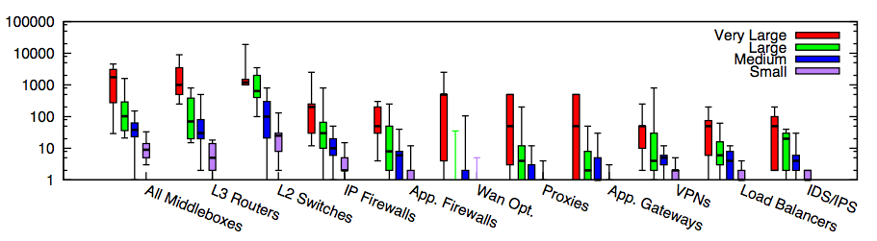
Why SDN or More Programmable Networks?
Modern networks contain increasingly more diverse types of equipment
In traditional settings, each type/vendor runs in its own hardware box
Substantial flexibility if more programmable nets
Small: <=1k hosts; Medium: 1k-10k; Large: 10k-100k; Very Large: >= 100k
Source: [Sherry, et. al SIGCOMM’12]
Notes:
为啥呢？因为total ownership cost少。1. 我server买了，3年合同以后可以自行切换。前三年load cisco的virtual router，后三年load juniper的virtual switch。再过三年load palo alto的virutal firewall 2. 设备performance更新，只需要换低层硬件，就可以扩展
Router, switch, firewall merge
Server + software, which include Router, Switch, FT
DC -> Cloud
ENT switch reducing; Cloud increasing
There are more virtual ports than physical ports, where the virtual ports are controlled by x86 software. Where software erodes hardware

Slide 8
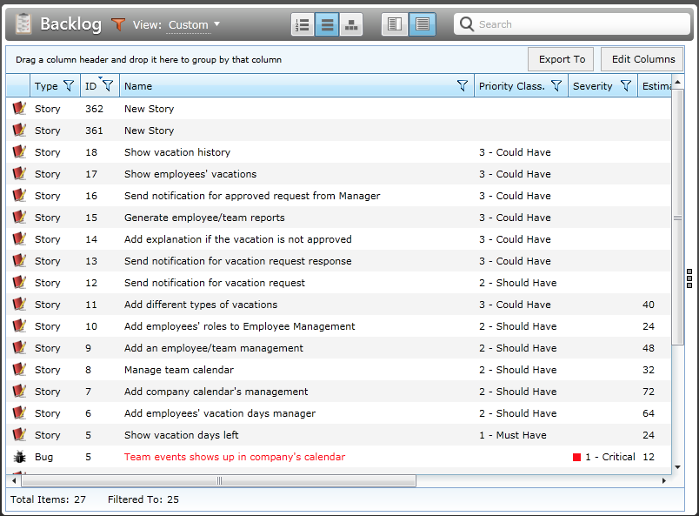
Why SDN or More Programmable Networks?
Network customization/feature requests can be a slow process. Open/programmable systems introduce competition and may allow more innovation.
Notes:
small (fewer than 1k hosts), medium (1k-10k hosts), large (10k-100k hosts), and
very large (more than 100k hosts) enterprise network

Slide 9

More Programmable Networks are a Well Recognized Trend
“We are focusing on a market transition involving the move toward more programmable, flexible, and virtual networks… This transition is focused on moving from a hardware-centric approach for networking to a virtualized network environment that is designed to enable flexible, application-driven customization of network infrastructures. -- Cisco Annual Report (pp2), Nov. 2015
Notes:
“The cost to operate networks is too high and growing too fast and you can’t find enough people to manage these things anymore. It’s time for change.” -- Nick Lippis, ONUG /Fidelity, 2013
To appeal to companies looking for more highly customized systems, Cisco has also opened up its software to programmers in new ways, making it easier for clients to write their own apps for Cisco products.
http://www.bloomberg.com/news/articles/2015-11-05/cisco-s-new-ceo-embraces-the-cloud

Slide 10
What is SDN: A New Control-Plane Abstraction View
Major advances in many fields of computer science are based on simple, powerful abstractions
“Modularity based on abstraction is the way things get done.” -- Barbara Liskov
A major lacking of networking is that we do not have enough good abstractions in network control plane
Three key areas for abstractions [Shenker’11]: forwarding, distribution, configuration
Notes:
Hide details; Provide automatic optimization
Theory: Turing machine; systems: DB/relational algebra; OS/Virtual memory/thread; PL: low level language to higher level languages. Networking layer architecture is abstractions for data plane. Major advance is possible if we introduce the right abstractions in the network control plane.

Slide 11
Our Goal
SDN
Control
Realize one key benefit of SDN: Better programming abstractions, tools to allow easier, more efficient, more reliable, more secure, high-level network control and management.
State
standard control
protocol
Datapath
Datapath
Datapath
Notes:
Benefits of abstraction: hide details, automatic instead of manual optimization, hide dynamics, hide resource limitations.

Slide 12
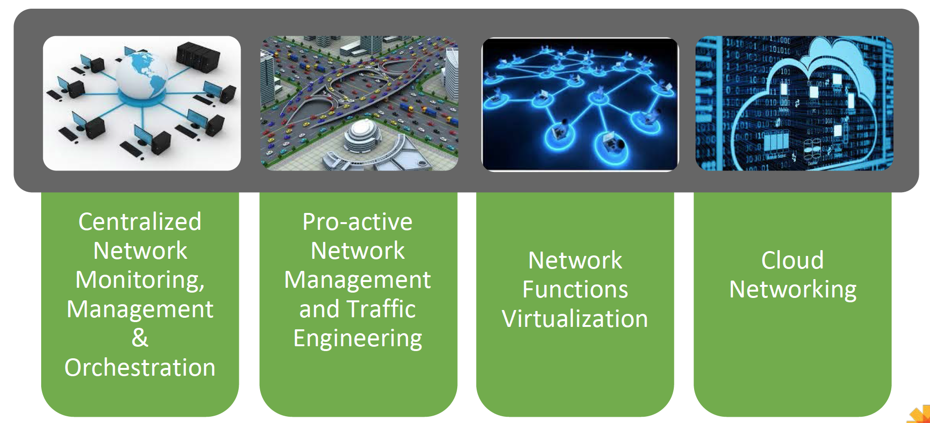
Some Main Current Use Cases of SDN
Source: Neela Jacques, July 2015.
Notes:
At a high level, abstraction is to hide issues that others do not want to or hard to do things.

Slide 13
Outline
What and why SDN?
Current SDN programming systems
Notes:
At a high level, abstraction is to hide issues that others do not want to or hard to do things.

Slide 14
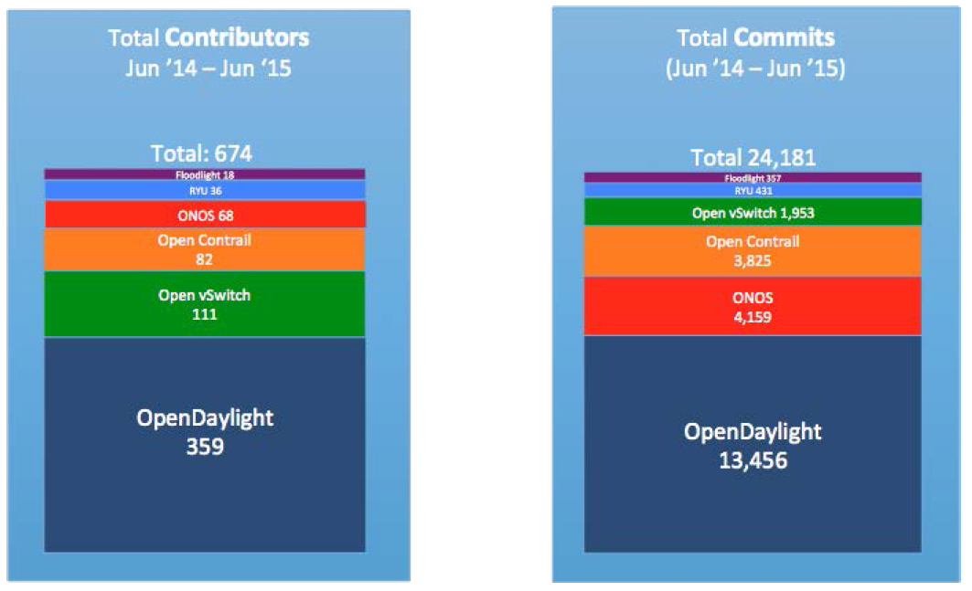
State of Current (Open Source) Players
Source: Neela Jacques, July 2015.

Slide 15
OpenDaylight Architecture
Network Devices
Applications
Network Applications Orchestration & Services
Network Devices
Applications
Network Devices
Applications
Controller
NETCONF SERVER
Protocol Plugin
...
Protocol Plugin
App/Service Plugin
...
App/Service Plugin
RESTCONF
Plugins & Applications
Config Subsystem
Model-Driven SAL (MD-SAL)
Controller Platform
Messaging
Data Store
Clustering
Remote Controller Instance
Remote Controller Instance
Source: Ed Warnicke, July 27, 2015.
15

Slide 16
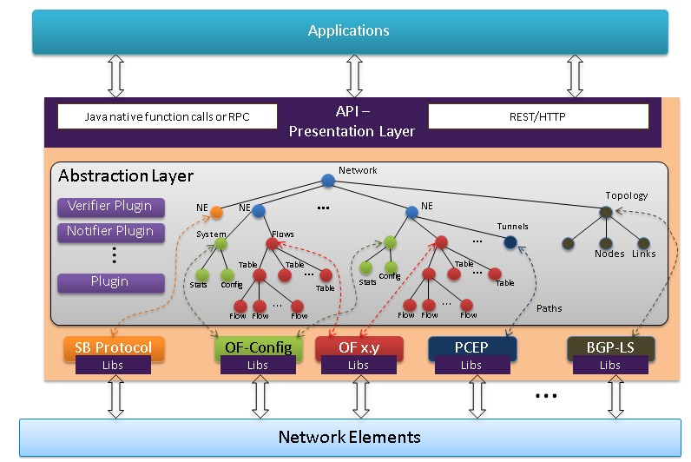
OpenDaylight Architecture
https://wiki.opendaylight.org/view/OpenDaylight_Controller:Architectural_Framework

Slide 17
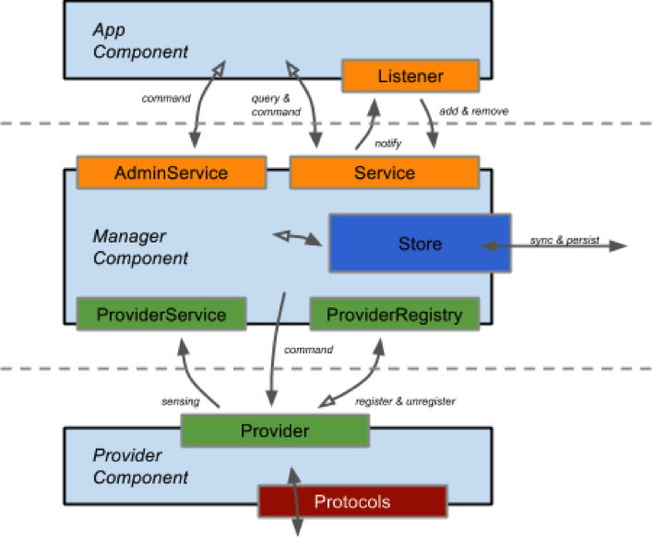
ONOS Architecture
https://wiki.onosproject.org/display/ONOS/System+Components
Notes:
http://api.onosproject.org/1.1.0/org/onosproject/store/Store.html DeviceStore, HostStore, LinkStore, TopologyStore collect info from below
FlowRuleStore supports forwarding abstractions
IntentStore

Slide 18

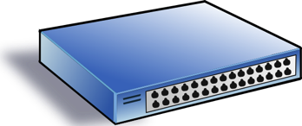
An Abstract View: Focus of Current SDN Systems is Data Store (Distribution)
logically centralized data store
Network View
Service/ Policy
NE Datapath
NE Datapath

Slide 19

What is Missing?
Program
logically centralized data store
Network View
Service/ Policy
NE Datapath
NE Datapath

Slide 20
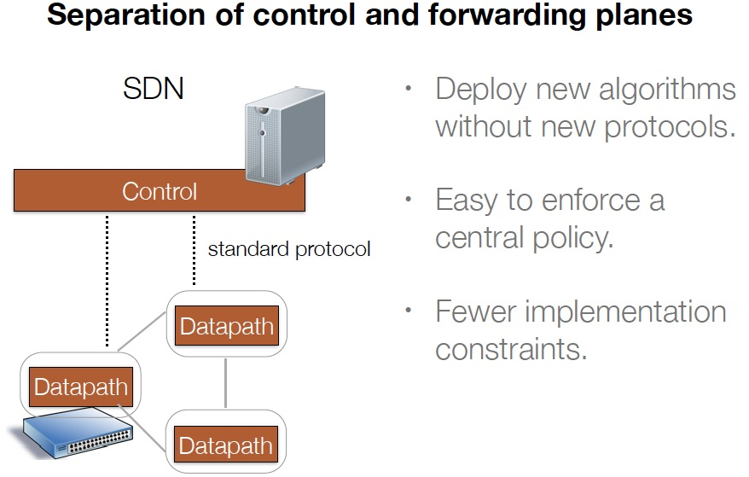
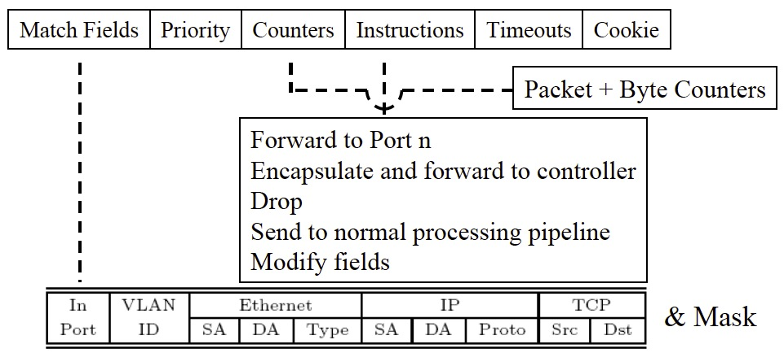
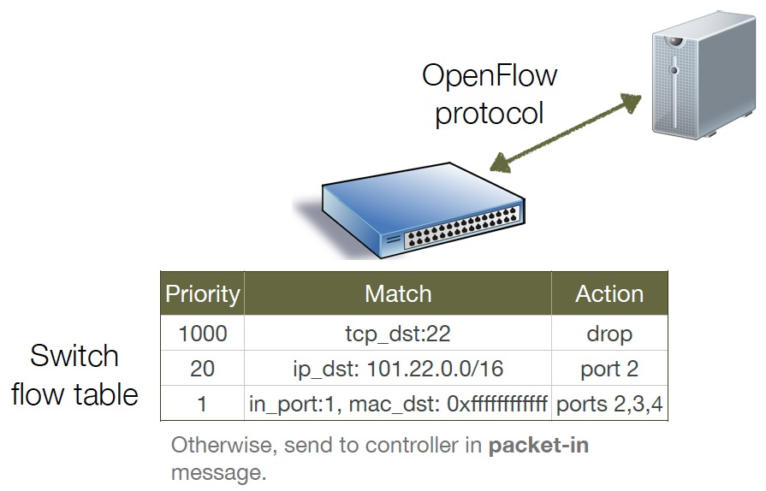
Datapath Model
Low-level TCAM based computing model with limited resources

Slide 21


Example: A Simple SDN Controller
badPort = 22 // policy hostTbl = {A:1,B:2, C:3,D:4} // net view
def onPacketIn(p):
if badPort == p.tcp_dst: drop
else: forward([hostTbl(p.eth_dst)])
1
2
3
4
A
B
C
D
Notes:
SDN is a recent hot topic. During a recent NSF panel, many proposals are on SDN. A common feedback is if a propsal can be related with SDN.

Slide 22
Controller Program with Flow Table Management
hostTbl = {A:1,B:2,C:3,D:4}
def onPacketIn(p):
if 22 == p.tcp_dst: drop
installRule({‘match':{'tcp_dst':22}, ‘action’:[]})
else: forward([hostTbl(p.eth_dst)])
installRule({‘match’: {‘eth_dst’:p.eth_dst, ’tcp_dst’!=22},
‘action’:[hostTbl(p.eth_dst)]})
Notes:
SDN is a recent hot topic. During a recent NSF panel, many proposals are on SDN. A common feedback is if a propsal can be related with SDN.

Slide 23
Controller Program with Flow Table Management
hostTbl = {A:1,B:2,C:3,D:4}
def onPacketIn(p):
if 22 == p.tcp_dst: drop
installRule({‘priority’:1, ‘match’:{'tcp_dst':22}, ‘action’:[]})
else: forward([hostTbl(p.eth_dst)])
installRule({‘priority’:0, ‘match’: {‘eth_dst’:p.eth_dst},
‘action’:[hostTbl(p.eth_dst)]})
Notes:
SDN is a recent hot topic. During a recent NSF panel, many proposals are on SDN. A common feedback is if a propsal can be related with SDN.

Slide 24
Does the Program Work?
Switch
EthDst:A,
TcpDst:80
{`priority`:0,’match’:{‘eth_dst’:A},'action':[1]}
EthDst:A,
TcpDst:22
Controller
def onPacketIn(p):
if 22 == p.tcp_dst: drop
installRule({`priority`:1,’match’:{‘tcp_dst':22},'action':[]})
else:
installRule({`priority`:0,’match’:{‘eth_dst’:p.eth_dst},
'action':[hostTbl(p.eth_dst)]})
forward([hostTbl(p.eth_dst)])
Notes:
Unfortunately, this program has a bug. To see where the program goes wrong, let’s watch what happens when we connect this controller to a single switch and let two packets arrive. Both packets have destination mac A. The red packet is to TCP destination 80, while the green packet is to TCP destination 22. When the red packet arrives, the switch has an empty flow table and sends the packet to the controller. The controller determines that the packet should be forwarded to the next hop, and installs the appropriate rule. The red packet returns to the switch and moves onward. Now, the port 22 packet arrives at the switch, and instead of being dropped or sent to the controller, it matches the low priority rule for Ethernet destination A and is therefore forwarded onward. This violates the user’s intentions and may represent a security violation.

Slide 25
Approach I (OVS): Using Exact Match
hostTbl = {A:1,B:2,C:3,D:4}
def onPacketIn(p):
if 22 == p.tcp_dst: drop
installRule({‘priority’:1, ‘match’:exactMatch(p), ‘action’:[]})
else: forward([hostTbl(p.eth_dst)])
installRule({‘priority’:0, ‘match’:exactMatch(p),
‘action’:[hostTbl(p.eth_dst)]})
Notes:
SDN is a recent hot topic. During a recent NSF panel, many proposals are on SDN. A common feedback is if a propsal can be related with SDN.

Slide 26
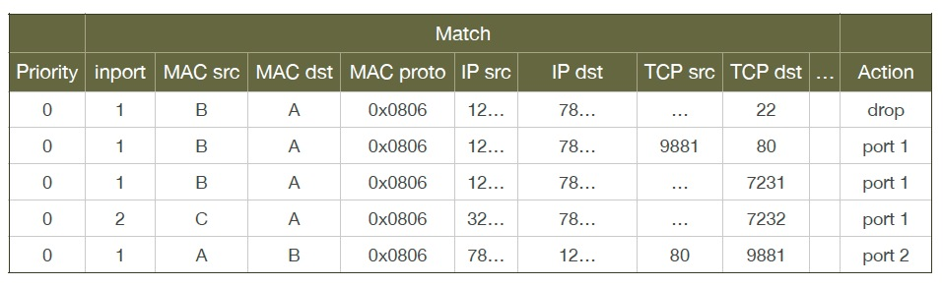
Problems of Approach I
Each new TCP flow delayed for flow setup (10-100 ms)
Number of flow table rules may exceed capacity (typically a few thousands)

Slide 27
Approach 2: Declarative Policy Languages
Probably the most well-known is Pyretic [NSDI’13]
if_(match(dstport(22)), drop,
if_(match(dstmac=EthAddr(a)), fwd(1),
if_(match(dstmac=EthAddr(b)), fwd(2),
if_(match(dstmac=EthAddr(c)), fwd(3),
if_(match(dstmac=EthAddr(d)), fwd(4),
flood() )))))
Notes:
SDN is a recent hot topic. During a recent NSF panel, many proposals are on SDN. A common feedback is if a propsal can be related with SDN.

Slide 28
Outline
What and why SDN?
Current SDN programming systems
Algorithmic SDN programming
Notes:
At a high level, abstraction is to hide issues that others do not want to or hard to do things.

Slide 29
Goal
Can we let programmers write the most obvious (=> data path independent) code:
… and we automatically generate correct, highly-optimized data path?
def onPacketIn(p) if 22 == p.tcp_dst: drop
else: forward([hostTbl(p.eth_dst)])
Notes:
SDN is a recent hot topic. During a recent NSF panel, many proposals are on SDN. A common feedback is if a propsal can be related with SDN.

Slide 30
Big Picture: Before
Step 1. Make Decisions
User Level
Step 2. Generate Rules
Controller Library
Under the hood
Switches
Notes:
So today, Openflow programmers are responsible for deciding both how to forward packets and how to configure flow tables. We observe that programmers will be motivated by performance goals to use wildcard rules and that reasoning about wildcard rules is complex and introduces a substantial risk of misconfiguration.

Slide 31
Big Picture: After
User Level
Step 1. Make Decisions
Step 2. Generate Rules
OF Controller Library
Under the hood
OF Switches
Notes:
Therefore, we ask whether it is possible to fully automate the generation of high quality flow tables, thereby removing this task from the programmer’s responsibility, simplifying their programs and eliminating this source of errors.
We call the remaining part of the user’s program, an “algorithmic policy”.

Slide 32
Algorithmic SDN Programming Abstraction: User’s View
Conceptually user’s network control function f is invoked on every packet entering the network.
f expressed in a general purpose language (e.g., Java, Python), describing how a packet should be routed, not how data path flow tables are configured
f: packet route
Notes:
...
Where packet provides access to packet attributes, env provides access to environment state, such as topology and host locations, and the route can be a unicast route, a null route or a multicast route.
...

Slide 33
Example Algorithmic Policy in Java
Route f(Packet p) {
if (p.tcpDstIs(22)) return null();
else {
Location sloc = hostTable(p.ethSrc());
Location dloc = hostTable(p.ethDst());
Route path = myRoutingAlg(topology(), sloc,dloc);
return path;
}
}
Route myRoutingAlg(Topology topo, Location sLoc, Location dloc) {
if ( isSensitive(sLoc) ) return secureRoutingAlg(topo, sloc, dloc);
else return standardRoutingAlg(topo, sloc, dloc);
}
Does not specify anything on flow tables!
Notes:
Here is an example algorithmic program, written in Java.
Explain program.
Note that the program does not specify flow table configuration.
So the programming model makes the programmer’s life easy: just take a packet and say what to do with it.

Slide 34
Outline
Current SDN programming systems
Algorithmic SDN programming
Programming model
Maple
Notes:
At a high level, abstraction is to hide issues that others do not want to or hard to do things.

Slide 35
Maple: Challenge and Basic Idea
Challenge: How is it possible that one can derive datapath (flow-tables) from a datapath-oblivious controller function f?
Basic idea:
There are two representations of computation
A sequence of instructions (whitebox)
Memorization tables (blackbox)
Although the decision function f does not specify how flow tables are configured, if for a given decision (e.g., drop), we know the dependency of the decision, we can construct the flow tables (aka, memorization tables).
Notes:
...
Where packet provides access to packet attributes, env provides access to environment state, such as topology and host locations, and the route can be a unicast route, a null route or a multicast route.
...

Slide 36
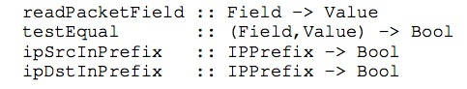
Maple: Basic Idea
Only requirement: Programs use simple library to access pkt attributes:
Library provides both convenience and more importantly, decision dependency!
Notes:
- Switches have limited TCAM capacity for rules; hence, craft rule sets to optimize TCAM utilization.
- Generated rules may become invalid when network or policy state changes. Need to detect and repair inconsistency with minimal disruption.
- Some policies are inherently hard to distribute and generate many central executions.
On the other hand implementing algorithmic policies is challenging.
We know that naive solutions -- process every packet at controller or use only exact match rules -- perform poorly.
Static analysis to determine layout of flow tables is possible, but has drawbacks; in particular static analysis of general purpose language programs is typically conservative. Furthermore, relying on static analysis will cause the system to become substantially dependent on the source language in which we write algorithmic policies.

Slide 37
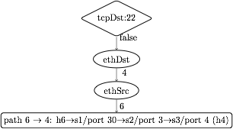
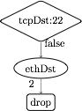
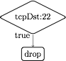
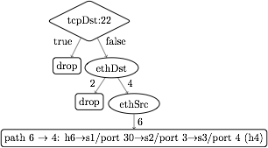
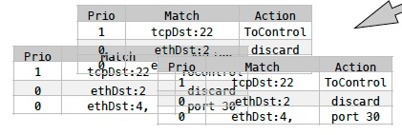
Dynamic Tracing: Abstraction to Flow Tables
1. Observes decision dependency of f on pkt attributes.
2. Builds a trace tree (TT), a universal (general), partial decision tree representation of any f.
3. Compile trace tree to generate flow tables (FTs).
Notes:
Instead, we introduce Maple, a system that implements algorithmic policies using a fully dynamic compilation method and which does not depend on the source language used to express the algorithmic policy.
Maple works by repeatedly executing the user’s algorithmic policy f on packets entering the network, generalizing the outcome to other packets by observing traces of data accesses made during the execution.
Maple then accumulates these traces into a trace tree, which is a partial decision tree of the input algorithmic policy, f.
Finally, Maple compiles flow tables (FTs) for all the switches in the network from the trace tree. The compilation is done so that packets for which Maple has not yet successfully inferred a forwarding decision are sent back to the controller to ensure that Maple continues to execute f and refine its trace tree.

Slide 38
Policy
EthSrc:1,
EthDst:2,
TcpDst:80
Route f(Packet p) {
if (p.tcpDstIs(22))
return null();
else {
Location sloc =
hostTable(p.ethSrc());
Location dloc =
hostTable(p.ethDst());
Route path =
myRoutingAlg(
topology(),sloc,dloc);
return path;
}
}
Assert: TcpDst==22
false
Read: EthSrc
1
Read: EthDst
2
path1
Notes:
We use the example Java algorithmic policy to illustrate the tracing method. Suppose Maple executes the algorithmic policy on a packet with Ethernet source 1, Ethernet dest 2 and tcp destination 80. As the packet moves through the policy, Maple collects a trace of the execution.
When this packet arrives at the check on tcp destination, Maple records the assertion, and its outcome. In this case, the outcome is false. The program proceeds to the else branch, where it reads the source and destination addresses, both of which Maple logs. Finally, the program returns the computed path.

Slide 39
Policy
Trace Tree
EthDst:1,
TcpDst:22
Route f(Packet p) {
if (p.tcpDstIs(22))
return null();
else {
Location sloc =
hostTable(p.ethSrc());
Location dloc =
hostTable(p.ethDst());
Route path =
myRoutingAlg(
topology(),sloc,dloc);
return path;
}
}
Assert: TcpDst==22
Assert: TcpDst==22
true
null
true
false
Read: EthSrc
?
1
Read: EthDst
2
path1
Notes:
Maple then uses this trace to begin generating the Trace Tree. In this case, Maple still doesn’t know what will happen if the assertion is true, and it therefore adds a placeholder under the true branch.
Now, if we execute f on a packet to tcp destination 22, the assertion is true, and the packet is dropped. Maple logs this new trace and uses it to refine its Trace Tree, filling in the true branch of the assertion.

Slide 40
Policy
Trace Tree
EthDst:1,
TcpDst:22
Route f(Packet p) {
if (p.tcpDstIs(22))
return null();
else {
Location sloc =
hostTable(p.ethSrc());
Location dloc =
hostTable(p.ethDst());
Route path =
myRoutingAlg(
topology(),sloc,dloc);
return path;
}
}
Assert: TcpDst==22
Assert: TcpDst==22
true
null
true
false
Read: EthSrc
null
1
Read: EthDst
2
path1
Notes:
Maple then uses this trace to begin generating the Trace Tree. In this case, Maple still doesn’t know what will happen if the assertion is true, and it therefore adds a placeholder under the true branch.
Now, if we execute f on a packet to tcp destination 22, the assertion is true, and the packet is dropped. Maple logs this new trace and uses it to refine its Trace Tree, filling in the true branch of the assertion.

Slide 41
Trace Tree Formal Spec
Assert: TcpDst==22
A tree w/ 4 types of nodes
T node: assertion on packet attributes
V node: multi-way branching on a packet attribute
L node: leaf node labeled w/ action
? node: unknown
TT search: traverse tree for a given packet to determine action or no answer
TT correctness: if TT records an answer for a given packet, the answer is the same as the original algorithm
true
false
Read: EthSrc
?
1
Read: EthDst
2
path1
Notes:
On the other hand implementing algorithmic policies is challenging.
We know that naive solutions -- process every packet at controller or use only exact match rules -- perform poorly.
Static analysis to determine layout of flow tables is possible, but has drawbacks; in particular static analysis of general purpose language programs is typically conservative. Furthermore, relying on static analysis will cause the system to become substantially dependent on the source language in which we write algorithmic policies.

Slide 42
Trace Tree => Flow Table
tcpDst ==22
True
False
drop
ethDst
match:{tcpDst==22}
4
2
drop
ethSrc
match:{tcpDst!=22, ethDst:2}
6
port 30
match:{tcpDst!=22, ethDst:4,ethSrc:6}
Notes:
The basic compilation algorithm is actually very simple, and we explain it here in the context of an example trace tree. For simplicity the leaves are labelled with switch-specific actions, such as forward on some ports or drop.
The basic algorithm generates one rule for each execution of f, and each execution of f is stored as a path from the root of the trace tree to a leaf. For example, the right-most path in this tree resulted from an execution that observed that tcpDst!=22 and ethDst==4 and ethSrc==6.
The leaf stores the action and the match condition can be obtained from the path from the root to the leaf. In this case, we would want to match on tcpDst!=22, ethDst==4 and ethSrc==6. Of course, as we described earlier, we cannot match on tcpDst!=22, and so instead we will generate a rule at some higher priority that matches on the condition which we wish to negate. This rule, which we call a “barrier rule” ensures that the rule for the execution which we are considering only fires when the condition is false.
We observe that all the rules that require tcpDst!=22 are under the False branch of the assertion node and all the rules that require tcpDst==22 are under the True branch of the assertion node. Therefore, we can determine the priority level of the barrier rule by first generating rules and assigning priorities to the False branch of the node, and then assigning the priority of the barrier rule to have the next higher priority. Then we can assign priorities to the True branch. Hence, by generating rules in-order from False to True, we can correctly assign priorities to rules.
Finally, since the subtree under the True branch may not completely describe how to handle all tcpDst==22 packets, some packets with tcpDst==22 may fall through to the reach the barrier rule. Therefore, the action for the barrier rule must be ToController, so that we can continue to trace f correctly.

Slide 43
Trace Tree => Flow Table
tcpDst ==22
True
False
drop
ethDst
match:{tcpDst==22}
4
2
drop
ethSrc
match:{tcpDst!=22, ethDst:2}
6
port 30
barrier rule:
match:{tcpDst!=22, ethDst:4,ethSrc:6}
match:{tcpDst==22}
action:ToController
Priority
Notes:
The basic compilation algorithm is actually very simple, and we explain it here in the context of an example trace tree. For simplicity the leaves are labelled with switch-specific actions, such as forward on some ports or drop.
The basic algorithm generates one rule for each execution of f, and each execution of f is stored as a path from the root of the trace tree to a leaf. For example, the right-most path in this tree resulted from an execution that observed that tcpDst!=22 and ethDst==4 and ethSrc==6.
The leaf stores the action and the match condition can be obtained from the path from the root to the leaf. In this case, we would want to match on tcpDst!=22, ethDst==4 and ethSrc==6. Of course, as we described earlier, we cannot match on tcpDst!=22, and so instead we will generate a rule at some higher priority that matches on the condition which we wish to negate. This rule, which we call a “barrier rule” ensures that the rule for the execution which we are considering only fires when the condition is false.
We observe that all the rules that require tcpDst!=22 are under the False branch of the assertion node and all the rules that require tcpDst==22 are under the True branch of the assertion node. Therefore, we can determine the priority level of the barrier rule by first generating rules and assigning priorities to the False branch of the node, and then assigning the priority of the barrier rule to have the next higher priority. Then we can assign priorities to the True branch. Hence, by generating rules in-order from False to True, we can correctly assign priorities to rules.
Finally, since the subtree under the True branch may not completely describe how to handle all tcpDst==22 packets, some packets with tcpDst==22 may fall through to the reach the barrier rule. Therefore, the action for the barrier rule must be ToController, so that we can continue to trace f correctly.

Slide 44
Trace Tree => Flow Table
Simple, classical in-order tree traversal generates flow table rules!
tcpDst ==22
3
1
True
False
2
ethDst
drop
match:{tcpDst==22}
4
2
drop
ethSrc
match:{tcpDst!=22, ethDst:2}
6
port 30
barrier rule:
match:{tcpDst!=22, ethDst:4,ethSrc:6}
match:{tcpDst==22}
action:ToController
Priority
Notes:
The basic compilation algorithm is actually very simple, and we explain it here in the context of an example trace tree. For simplicity the leaves are labelled with switch-specific actions, such as forward on some ports or drop.
The basic algorithm generates one rule for each execution of f, and each execution of f is stored as a path from the root of the trace tree to a leaf. For example, the right-most path in this tree resulted from an execution that observed that tcpDst!=22 and ethDst==4 and ethSrc==6.
The leaf stores the action and the match condition can be obtained from the path from the root to the leaf. In this case, we would want to match on tcpDst!=22, ethDst==4 and ethSrc==6. Of course, as we described earlier, we cannot match on tcpDst!=22, and so instead we will generate a rule at some higher priority that matches on the condition which we wish to negate. This rule, which we call a “barrier rule” ensures that the rule for the execution which we are considering only fires when the condition is false.
We observe that all the rules that require tcpDst!=22 are under the False branch of the assertion node and all the rules that require tcpDst==22 are under the True branch of the assertion node. Therefore, we can determine the priority level of the barrier rule by first generating rules and assigning priorities to the False branch of the node, and then assigning the priority of the barrier rule to have the next higher priority. Then we can assign priorities to the True branch. Hence, by generating rules in-order from False to True, we can correctly assign priorities to rules.
Finally, since the subtree under the True branch may not completely describe how to handle all tcpDst==22 packets, some packets with tcpDst==22 may fall through to the reach the barrier rule. Therefore, the action for the barrier rule must be ToController, so that we can continue to trace f correctly.

Slide 45
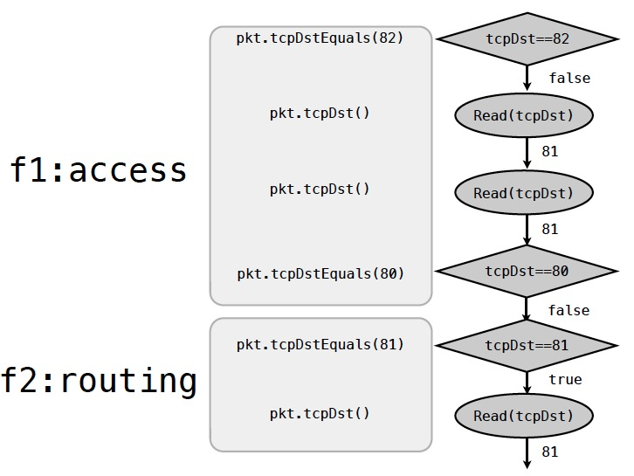
Handling User Inefficiency: Redundant Trace

Slide 46
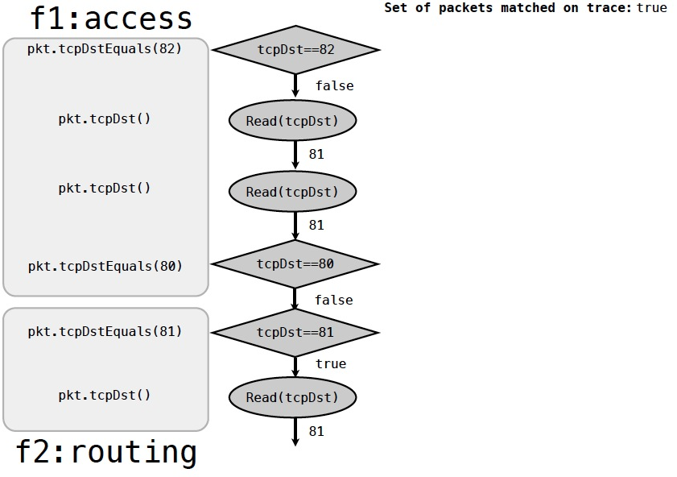
Example: Trace Reduction

Slide 47
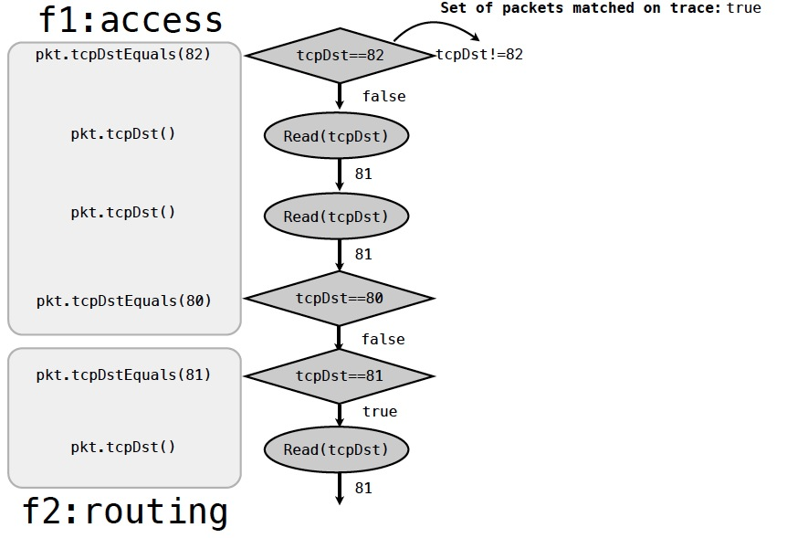
Example: Trace Reduction

Slide 48
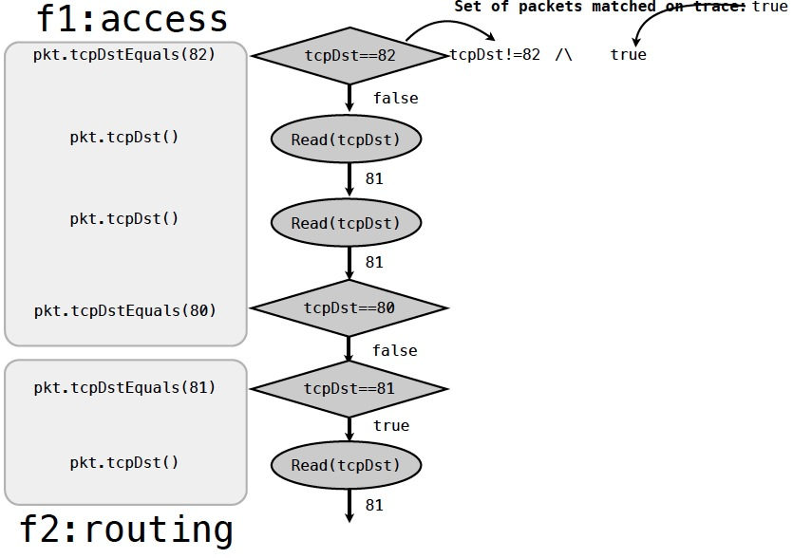
Example: Trace Reduction

Slide 49
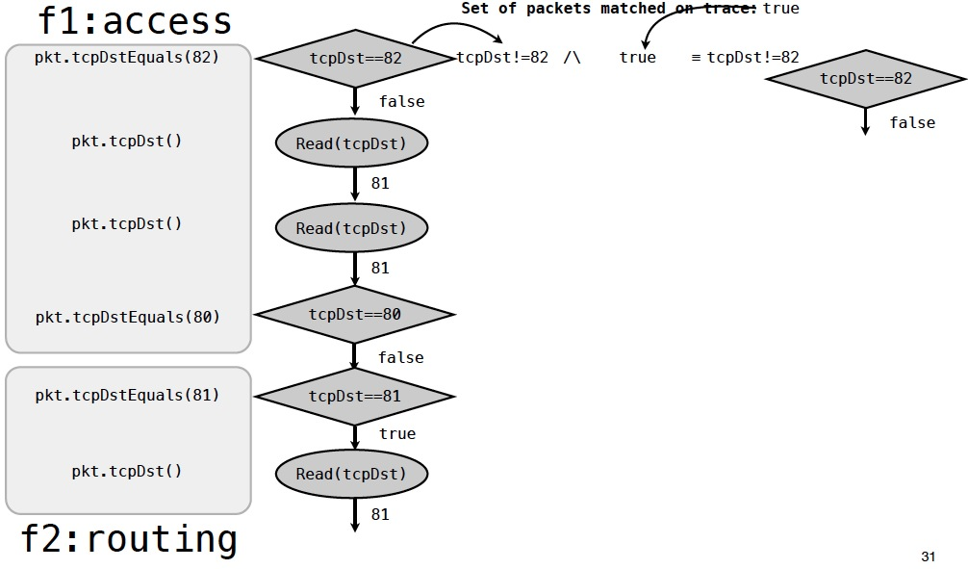
Example: Trace Reduction
Notes:
SDN is a recent hot topic. During a recent NSF panel, many proposals are on SDN. A common feedback is if a propsal can be related with SDN.

Slide 50
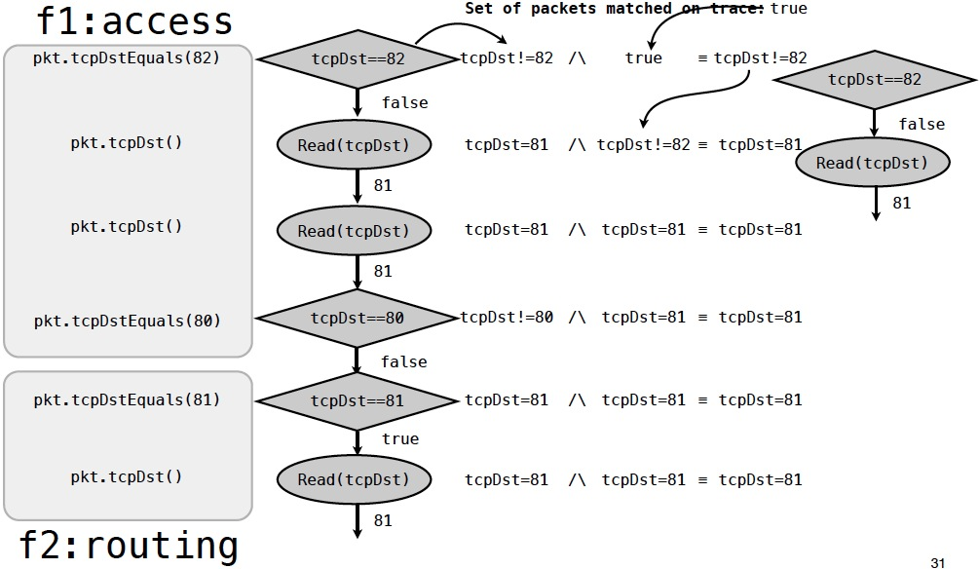
Example: Trace Reduction

Slide 51
Example: Trace Reduction

Slide 52
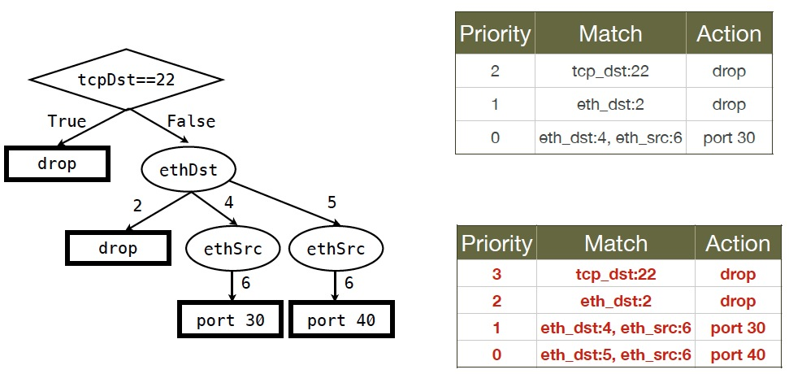
Flow Table Optimization

Slide 53
Flow Table Optimization

Slide 54
Flow Table Optimization

Slide 55
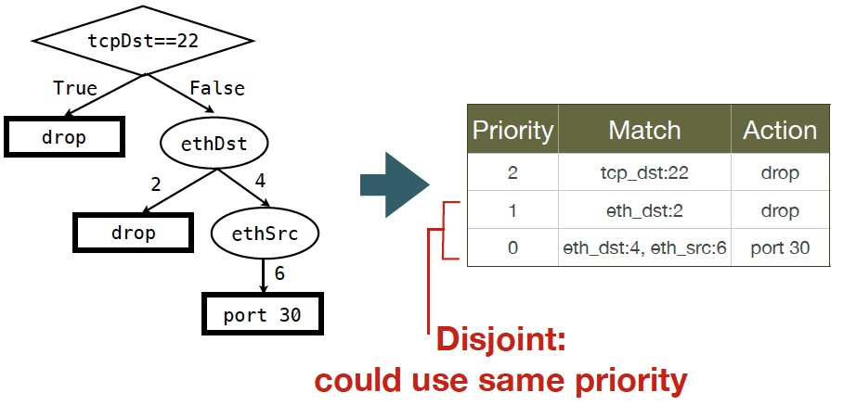
Unnecessary Priority Levels

Slide 56
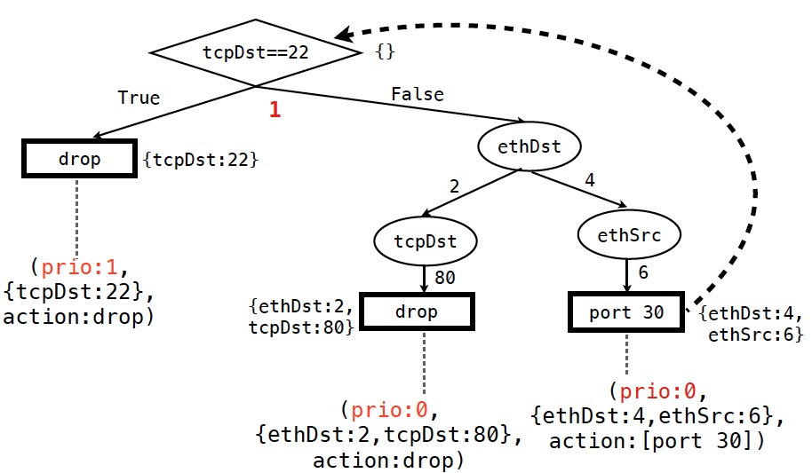
Minimizing Priority Levels: Increasing at T Nodes Only

Slide 57
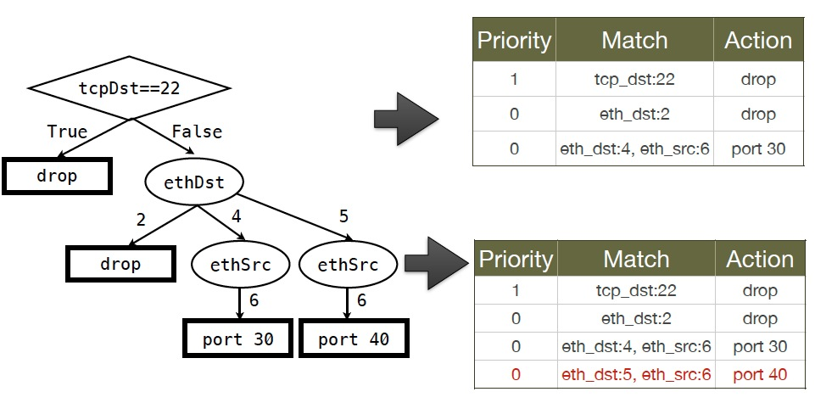
Minimizing Priority Levels: Increasing at T Nodes Only

Slide 58
Minimizing Priority Levels: Increasing at T Nodes Only

Slide 59
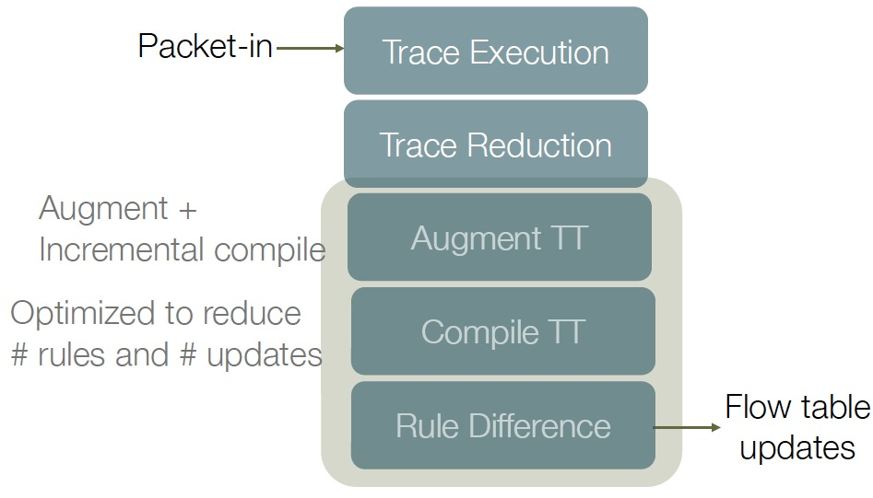
Maple/Basic Runtime

Slide 60
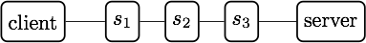
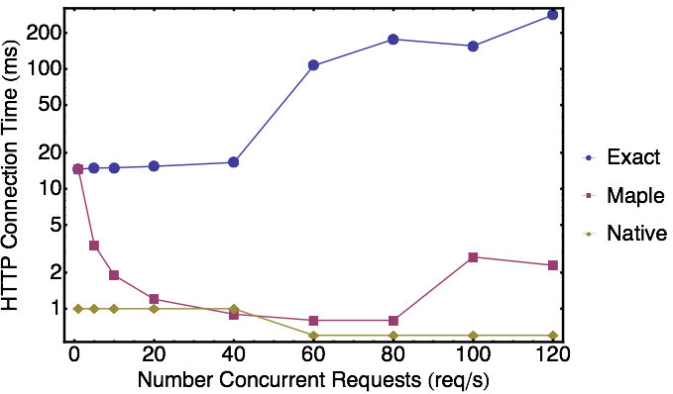
Maple/Basic Evaluation
3 real HP 5406 switches, client on one side, server on the other.
Client performs X HTTP reqs/s using httperf.
Measure average HTTP connection time as X varies.
Compare exact & maple
Exact: up to 282 ms average
Run-time: 1-2 ms: 100x reduction.
Notes:
We measured the effect of using Maple-generated rules in a network using 3 real HP 5406 Openflow-enabled switches arranged in a linear topology. We connect a client and a web server on either side of the switches. The client issues HTTP requests to the web server and we measure the average HTTP connection time as we vary the rate at which HTTP connections are created at the client. We use an algorithmic policy that simple routes traffic based on the source and destination addresses. We compare the performance when using Maple’s rule generation method with the performance when generating only exact match rules and with the native L2 functionality of the switches.
We see that the performance of the exact match controller introduces substantial delay to the HTTP connection time, taking up to 282 ms when 120 requests are issued per second.
On the other hand, the Maple controller achieves a HTTP connection time of 2 ms at 120 requests per second, a 100x improvement. Maple’s performance closely matches that of the native L2 functionality up to about 100 requests per second.

Slide 61
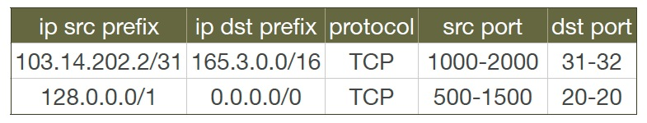
Evaluation: Maple as ACL Compiler
Access Control Lists (ACLs) commonly used in network management
Questions
How does one program ACL using Maple?
How does one combine ACL with other policies, e.g. routing, load balancing?
Notes:
To evaluate Maple, we apply it to an interesting problem: how to implement filter sets, such as access control lists that match on IP prefixes and TCP or UDP port ranges, on Openflow switches. This could be challenging, especially if we also want to solve the problem when the filter sets are combined with other policies, such as routing or load balancing policies.
We solve this problem with Maple by programming a simple filter set interpreter as an algorithmic policy, f.
The policy initially loads a filter set from a file, and then handles packets by just naively using the semantics of the filter set: iterate over filters in the filter set, test each filter against the packet and return an action based on the first matching filter.

Slide 62
Maple Example: ACL+Routing
void insert(ACLItem acl, int pos, List<ACLItem> acls) {
acls.add(pos, acl);
}
void delete(int pos, List<ACLItem> acls) {
acls.remove(pos);
}
boolean permit(Packet p, List<ACLItem> acls) {
for (ACLItem item : acls) {
if ( match(p, item) ) {
return item.action == PERMIT;
} }
return false;
}
List<ACLItem> acls;
Route f(Packet p) {
if ( ! permit(p, acls) ) {
return null();
}
Location sloc = hostTable(p.ethSrc());
Location dloc = hostTable(p.ethDst());
Route path = myRoutingAlg(topology(),sloc,dloc);
return path;
}

Slide 63
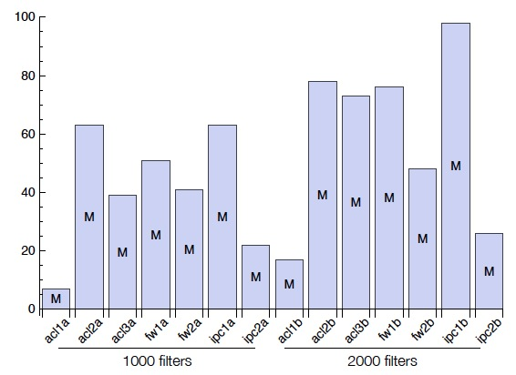
Benchmarking Compiler Quality
98 priority levels for 2000 IPC rules
Benchmark: Classbench filter sets and packet traces for 3 filter set types - ACL, FW, IPC - and two sizes - 1000 and 2000 filters per filter set.
Metric: #priority levels used
Only 9 priority levels for 1000 rules
Notes:
In this graph we show the number of priority levels used by the Maple-generated rules for the same filter sets. We see that Maple often uses very few priority levels. For example, acl1a uses just 9 priorities for roughly 1000 rules. Some policies cause Maple to use substantially more priorities - for example acl2b required 120 priorities for nearly 2000 rules.

Slide 64
Anatomy of a Network Control Function
Map<MAC, Location> hostTable; List<ACLItem> acls;
Route f(Packet p) {
hostTable.put(p.ethSrc(), p.ingressPort());
if ( !permit(p, acls) ) return drop;
Location src = p.ingressPort();
Location dst = hostTable.get( p.ethDst() );
Route path = myRoutingAlg(topology(), src, dst);
return path;
}
Has physical states
f uses physical states
External process may change the state
External process may change states
f uses policy state
Decision depends on pkt attributes
f depends on pkt attributes
Data path may need to detect change and update state

Slide 65
Outline
Current SDN programming systems
Algorithmic SDN programming
Programming model
Maple
Maple with auto-state-update
Notes:
At a high level, abstraction is to hide issues that others do not want to or hard to do things.

Slide 66
Implication
A general AP is a general function of the form:
f: (packet, state) (route, new-state, act)
When state changes, decision may change too.
If f() takes non-switch-implementable actions (e.g., causes state changes, sends packets), the packet should be punted back to the controller.
Notes:
Maintaining correctness despite state changes is one of the key challenges of controller programming

Slide 67
Existing Approaches on Handling State Dependency
Floodlight
Wait for timeout of existing rules
Problem: long delay; may not even be correct
Pyretic
Completely rerun (a declarative) program and then compare the differences
Problem: extreme low efficiency

Slide 68
Maple/ASU: Goal
Can we introduce simple mechanisms so that we can achieve efficient (e.g., incremental) updates after state dynamics?

Slide 69
Maple Mechanism
Only requirement: User program f uses simple library wrappers to access state variables
Reason: Provides both convenient data structures and importantly, again, decision dependency!

Slide 70
Policy
EthSrc:1,
EthDst:2,
TcpDst:80
Route f(Packet p) {
if (p.tcpDstIs(22))
return null();
else {
Location sloc =
hostTable(p.ethSrc());
Location dloc =
hostTable(p.ethDst());
Route path =
myRoutingAlg(
topology(),sloc,dloc);
return path;
}
}
Assert: TcpDst==22
false
Read: EthSrc
Dependency table (aka inverted index)
1 (hostTable, 1)
Component | Traces
Notes:
We use the example Java algorithmic policy to illustrate the tracing method. Suppose Maple executes the algorithmic policy on a packet with Ethernet source 1, Ethernet dest 2 and tcp destination 80. As the packet moves through the policy, Maple collects a trace of the execution.
When this packet arrives at the check on tcp destination, Maple records the assertion, and its outcome. In this case, the outcome is false. The program proceeds to the else branch, where it reads the source and destination addresses, both of which Maple logs. Finally, the program returns the computed path.

Slide 71
Policy
EthSrc:1,
EthDst:2,
TcpDst:80
Route f(Packet p) {
if (p.tcpDstIs(22))
return null();
else {
Location sloc =
hostTable(p.ethSrc());
Location dloc =
hostTable(p.ethDst());
Route path =
myRoutingAlg(
topology(),sloc,dloc);
return path;
}
}
Assert: TcpDst==22
false
Read: EthSrc
Dependency table (aka inverted index)
1 (hostTable, 1)
Component | Traces
(hostTable,1) | [false, 1]
Notes:
We use the example Java algorithmic policy to illustrate the tracing method. Suppose Maple executes the algorithmic policy on a packet with Ethernet source 1, Ethernet dest 2 and tcp destination 80. As the packet moves through the policy, Maple collects a trace of the execution.
When this packet arrives at the check on tcp destination, Maple records the assertion, and its outcome. In this case, the outcome is false. The program proceeds to the else branch, where it reads the source and destination addresses, both of which Maple logs. Finally, the program returns the computed path.

Slide 72
Policy
EthSrc:1,
EthDst:2,
TcpDst:80
Route f(Packet p) {
if (p.tcpDstIs(22))
return null();
else {
Location sloc =
hostTable(p.ethSrc());
Location dloc =
hostTable(p.ethDst());
Route path =
myRoutingAlg(
topology(),sloc,dloc);
return path;
}
}
Assert: TcpDst==22
false
Read: EthSrc
Dependency table (aka inverted index)
1 (hostTable, 1)
Read: EthDst
Component | Traces
(hostTable,1) | [false, 1]
(hostTable,2) | [false, 1,2]
2 (hostTable, 2)
Notes:
We use the example Java algorithmic policy to illustrate the tracing method. Suppose Maple executes the algorithmic policy on a packet with Ethernet source 1, Ethernet dest 2 and tcp destination 80. As the packet moves through the policy, Maple collects a trace of the execution.
When this packet arrives at the check on tcp destination, Maple records the assertion, and its outcome. In this case, the outcome is false. The program proceeds to the else branch, where it reads the source and destination addresses, both of which Maple logs. Finally, the program returns the computed path.

Slide 73
Policy
EthSrc:1,
EthDst:2,
TcpDst:80
Route f(Packet p) {
if (p.tcpDstIs(22))
return null();
else {
Location sloc =
hostTable(p.ethSrc());
Location dloc =
hostTable(p.ethDst());
Route path =
myRoutingAlg(
topology(),sloc,dloc);
return path;
}
}
Assert: TcpDst==22
false
Read: EthSrc
Dependency table (aka inverted index)
1 (hostTable, 1)
Read: EthDst
Component | Traces
(hostTable,1) | [false, 1]
(hostTable,2) | [false, 1,2]
topology | [false,1,2]
2 (hostTable, 2)
topology
path1
Notes:
We use the example Java algorithmic policy to illustrate the tracing method. Suppose Maple executes the algorithmic policy on a packet with Ethernet source 1, Ethernet dest 2 and tcp destination 80. As the packet moves through the policy, Maple collects a trace of the execution.
When this packet arrives at the check on tcp destination, Maple records the assertion, and its outcome. In this case, the outcome is false. The program proceeds to the else branch, where it reads the source and destination addresses, both of which Maple logs. Finally, the program returns the computed path.

Slide 74
Example Dependency Table
Assert: TcpDsd==22
Dependency table (aka inverted index)
Component | Traces
(hostTable,1) | [false, 1]
(hostTable,2) | [false, 1,2]
(hostTable,3) | [false, 3]
(hostTable,4) | [false, 3,4]
topology | [false,1,2],[false,3,4]
true
false
?
Read: EthSrc
1
3
(hostTable, 1)
(hostTable, 3)
Read: EthDst
Read: EthDst
2
4
(hostTable, 2)
(topology())
(hostTable, 4)
(topology())
path1
path2

Slide 75
Tradeoffs Between Tracking Overhead and Precision
Assert: TcpDsd==22
host 1
link[1]: 1
link[2]: 2
true
false
?
Read: EthSrc
1
3
link[3]: 1
link[4]: 2
(hostTable, 1)
Read: EthDst
Read: EthDst
host 2
2
4
Assume Dijkstra.
(hostTable, 2)
(topology())
(hostTable, 2)
(links, {1,2,3})
Dijkstra will visit only 3 links. There is no dependency on link[4].
path1
path2
Notes:
SDN is a recent hot topic. During a recent NSF panel, many proposals are on SDN. A common feedback is if a propsal can be related with SDN.

Slide 76
Using Dependency Table
Assert: TcpDsd==22
Dependency table (aka inverted index)
Component | Traces
(hostTable,1) | [false, 1]
(hostTable,2) | [false, 1,2]
(hostTable,3) | [false, 3]
(hostTable,4) | [false, 3,4]
topology | [false,1,2],[false,3,4]
true
false
?
Read: EthSrc
1
3
(hostTable, 1)
(hostTable, 3)
Read: EthDst
Read: EthDst
host 4 changes location =>
2
4
- Uses dependency table to locate dependent entries
(hostTable, 2)
(topology())
(hostTable, 4)
(topology())
path1
path2

Slide 77
Using Dependency Table
Assert: TcpDsd==22
Dependency table (aka inverted index)
Component | Traces
(hostTable,1) | [false, 1]
(hostTable,2) | [false, 1,2]
(hostTable,3) | [false, 3]
(hostTable,4) | [false, 3,4]
topology | [false,1,2],[false,3,4]
true
false
?
Read: EthSrc
1
3
(hostTable, 1)
(hostTable, 3)
Read: EthDst
Read: EthDst
host 4 changes location =>
2
4
- Uses dependency table to locate dependent entries
(hostTable, 2)
(topology())
(hostTable, 4)
(topology())
path1
path2

Slide 78
Using Dependency Table
Assert: TcpDsd==22
Dependency table (aka inverted index)
Component | Traces
(hostTable,1) | [false, 1]
(hostTable,2) | [false, 1,2]
(hostTable,3) | [false, 3]
(hostTable,4) | [false, 3,4]
topology | [false,1,2],[false,3,4]
true
false
?
Read: EthSrc
1
3
(hostTable, 1)
(hostTable, 3)
Read: EthDst
Read: EthDst
host 4 changes location =>
2
4
- Uses dependency table to locate dependent entries
(hostTable, 2)
(topology())
(hostTable, 4)
(topology())
path1
path2

Slide 79
Using Dependency Table
Assert: TcpDsd==22
Dependency table (aka inverted index)
Component | Traces
(hostTable,1) | [false, 1]
(hostTable,2) | [false, 1,2]
(hostTable,3) | [false, 3]
(hostTable,4) | [false, 3,4]
topology | [false,1,2],[false,3,4]
true
false
?
Read: EthSrc
1
3
(hostTable, 1)
(hostTable, 3)
Read: EthDst
Read: EthDst
host 4 changes location =>
2
4
- Uses dependency table to locate dependent entries
- Strong consistency: immediately clean up all related entries.
(hostTable, 2)
(topology())
(hostTable, 4)
(topology())
path1
path2

Slide 80
Using Dependency Table
Assert: TcpDsd==22
Dependency table (aka inverted index)
Component | Traces
(hostTable,1) | [false, 1]
(hostTable,2) | [false, 1,2]
(hostTable,3) | [false, 3]
(hostTable,4) | [false, 3,4]
topology | [false,1,2],[false,3,4]
true
false
?
Read: EthSrc
1
3
(hostTable, 1)
(hostTable, 3)
Read: EthDst
Read: EthDst
host 4 changes location =>
2
4
- Uses dependency table to locate dependent entries
- Fast repair: saves trigger packets and uses background to repair
(hostTable, 2)
(topology())
(hostTable, 4)
(topology())
path1
path2

Slide 81
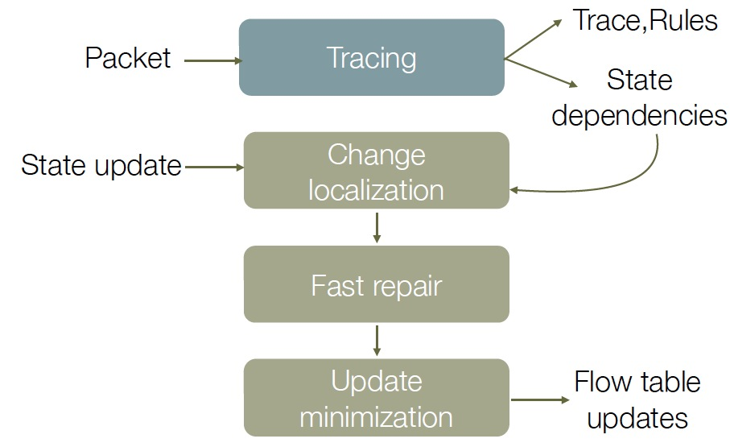
Maple/ASU Components

Slide 82
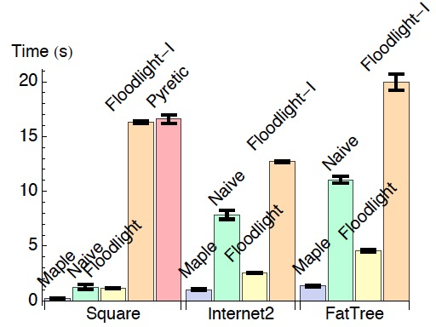
Evaluations: Time to Recover from Failures
Maple: 6x,2x,3x improvement over Floodlight!

Slide 83
Comments
Automatic, incremental state consistency removes a major source of network control complexity
It can have huge value in important settings such as Intent based network control
Notes:
At a high level, abstraction is to hide issues that others do not want to or hard to do things.

Slide 84
Example App: Maple-WAN
LossRate InetLoss;
Route onPacket(Packet p) { if (p.tcpDstIs(22)) { if (inetLoss < TARGET_LOSS) return port0;
else
return port1; }
…
}
port 1
port 0
Internet
dedicated link
Notes:
SDN is a recent hot topic. During a recent NSF panel, many proposals are on SDN. A common feedback is if a propsal can be related with SDN.

Slide 85
Outline
Current SDN programming systems
Algorithmic SDN programming
Programming model
Maple
Maple with auto-state-update
Maple demo (Jason/Tony)
Notes:
At a high level, abstraction is to hide issues that others do not want to or hard to do things.

Slide 86
Maple Demo

Slide 87
Outline
Current SDN programming systems
Algorithmic SDN programming
Programming model
Maple
Maple with auto-state-update
Problems of Maple using trace tree
Notes:
At a high level, abstraction is to hide issues that others do not want to or hard to do things.

Slide 88
Problems of Trace Tree
Quality: Compiles to only a single flow table
Latency: A reactive approach that waits for punted packets to begin unfolding the trace tree and generating rules

Slide 89
Why is Multi-Table Important for Quality (A Simple GBP Example)?
Map<MAC, ConditionSet> hostTable;
0. Route onPacketIn(Packet p) {
1. ConditionSet srcCond = hostTable.get( p.ethSrc() );
2. ConditionSet dstCond = hostTable.get( p.ethDst() );
3. if (srcCond != null && dstCond != null && pass(srcCond, dstCond) )
4. return pass;
5. else
return drop; }
Assume n hosts in hostTable
TT after pingall among the n hosts
ethSrc
Flow table from trace tree
a1
ethSrc | ethDst | Action
a₁ | a₁ | p₁
a₁ | a₂ | p₂
.. | … | …
a_{n} | a_{n} | p_{n2}
ethDst
ethDst
a1
an
a1
an
p1
pn
p
pn2
n² entries; more if under attacks

Slide 90
More Efficient Multi-Table (2 Tables) Design
Table 1
Assume k condition possibilities.
ethSrc | Action
a₁ | reg_{srcCond}=y₁ jump 2
a₂ | reg_{srcCond}=y₂ jump 2
.. | …
a_{n} | reg_{srcCond}=y_{n} jump 2
otherwise | drop
Table 2
regs_{rcSw} | ethDst | Action
y₁ | a₁ | p_{1,1}
y₁ | a₂ | p_{1,2}
.. | … | …
y_{k} | a_{n} | p_{k,n}
otherwise |  | drop
n + kn entries

Slide 91
More Efficient Multi-Table (3 Tables) Design
Table 1
Assume k condition possibilities.
ethSrc | Action
a₁ | reg_{srcCond}=y₁ jump 2
a₂ | reg_{srcCond}=y₂ jump 2
.. | …
a_{n} | reg_{srcCond}=y_{n} jump 2
otherwise | drop
Table 3
reg_{srcCond} | regs_{dstCond} | Action
y₁ | y₁ | p_{1,1}
y₁ | y₂ | p_{1,2}
.. | … | …
y_{k} | y_{n} | p_{k,k}
otherwise |  | drop
Table 2
ethDst | Action
a₁ | reg_{dstCond}=y₁ jump 3
a₂ | reg_{dstCond}=y₂ jump 3
.. | …
a_{n} | reg_{dstCond}=y_{n} jump 3
otherwise | drop
2n + k² entries
Assume n = 4000, k = 100 n²: 16,000,000 = 16M 40x n+kn: 4,000 + 400,000= 404K 22x
2n + k²: 8000 + 10,000 = 18K

Slide 92
Outline
Current SDN programming systems
Algorithmic SDN programming
Programming model
Maple/TT (aka Maple 1.0)
Maple/TT+auto-state-update (aka Maple 1.5)
Maple demo (Jason/Tony)
Problems of Maple using trace tree
USTC Multi-table for POP [Xinyu Feng, Chunhui’2015]
Notes:
At a high level, abstraction is to hide issues that others do not want to or hard to do things.

Slide 93
Add Slides on USTC/POP

Slide 94
Outline
Current SDN programming systems
Algorithmic SDN programming
Programming model
Maple/TT (aka Maple 1.0)
Maple/TT+auto-state-update (aka Maple 1.5)
Problems of Maple using trace tree
Magellan
Notes:
At a high level, abstraction is to hide issues that others do not want to or hard to do things.

Slide 95
Magellan: Ideal Design Goal
Proactively, fully generate flow tables
Problem
Switch has limited computation model
Execution paths that lead to non-switch-implementable actions (e.g., state update) still need to punt
Flow-table-unfriendly instructions may need to be punted as well
Realistic goal: Maximize flow table hit using minimal flow table size

Slide 96
An Example FT-Friendly AP
blockPort = 22 // policy
servers = [A, B, C, D] // net func hostTable = {A:0,B:1,C:2,D:3} // netview
def onPacketIn(p): // policy+netfunc+netvw -> DP
if blockPort == p.tcp_dst: return drop
else: s = servers[p.ip_src % len(servers)]
return forward([hostTable[s]])

Slide 97
An Example FT-Unfriendly AP
3 instead of 4 servers
blockPort = 22 // policy
servers = [A, B, C] // net func hostTable = {A:0,B:1,C:2,D:3} // netview
def onPacketIn(p): // policy+netfunc+netvw -> DP
if blockPort == p.tcp_dst: return drop
else: s = servers[p.ip_src % len(servers)]
return forward([hostTable[s]])
There is no compact representation of instruction pkt-attr % k, where there is no i. s.t. k = 2^{i}.

Slide 98
Proof that y = MAC % k has no Compact FT
Prove by contradiction.
Assume it has a flow table representation with less than 2⁴⁸ entries.
=> There is one flow rule with at least one wildcard bit Make all but one * bits 0. Assume the only * bit is the t-th bit. Assume MAC is m when the the t-th bit is 0.
=> m % k = (m+2^{t}) % k
p.ethSrc | Action
0000000 | y=0
...
1010*00010*000 | y=val
…

Slide 99
Magellan: Basic Idea
Basic idea:
Trace tree is a mostly blackbox approach, while Magellan starts with the other extreme---a whitebox approach.

Slide 100
Magellan: Basic Ideas
Function f consists of a sequence of instructions (in an intermediate representation) I₁, I₂, …, I_{n}.
Each instruction I is a mapping from input variable states to output variable states
InVar(I)₁ | InVar(I)₂ | InVar(I)₃ | OutVar(I)
1 | 1 | 1 | OutVar(I)=I(1,1,1)
…
…

Slide 101
Example
Map<MAC, ConditionSet> hostTable;
0. Route onPacketIn(Packet p) {
1. ConditionSet srcCond = hostTable.get( p.ethSrc() );
2. ConditionSet dstCond = hostTable.get( p.ethDst() );
3. if (srcCond != null && dstCond != null && pass(srcCond, dstCond) )
4. return port1;
5. else
return drop; }
Map<MAC, ConditionSet> hostTable;
Route onPacketIn(Packet p) {
I1. ConditionSet srcCond = hostTable.get( p.ethSrc() );
I2. ConditionSet dstCond = hostTable.get( p.ethDst() );
I3. branch [srcCond != null && dstCond != null && pass(srcCond, dstCond) ] I4 I5
I4. return port1
I5. return drop

Slide 102
Example
Map<MAC, ConditionSet> hostTable;
Route onPacketIn(Packet p) {
I1. ConditionSet srcCond = hostTable.get( p.ethSrc() );
I2. ConditionSet dstCond = hostTable.get( p.ethDst() );
I3. branch [srcCond != null && dstCond != null && pass(srcCond, dstCond) ] I4 I5
I4. return port1
I5. return drop
I1
I2
I3
p.ethSrc | Action
1 | srcCond₁ jump I2
2
...
2⁴⁸ | srcCond_{2^48} jump I2
p.ethDst | Action
1 | dstCond₁ jump I3
2
...
2⁴⁸ | dstCond_{2^48} jump I3
srcCond | dstCond | Action
srcCond₁ | dstCond₁ | jump I4
… |  | jump I5
…

Slide 103
Problem of Naïve Table Mapping
Table construction does not consider available state info: only the n values in current hostTable state are needed. Hence table size should be n+1, not 2⁴⁸
We say I1 is a compact-mapable (CM) statement.
I1
p.ethSrc | Action
1 | srcCond₁ jump I2
2
...
2⁴⁸ | srcCond_{2^48} jump I2
p.ethSrc | Action
a₁ | srcCond_{a1} jump I2
a₂
.. | …
a_{n} | srcCond_{an} jump I2
otherwise | srcCond=null
I1. ConditionSet srcCond = hostTable.get( p.ethSrc() );

Slide 104
More Examples of CM Statements
y = p.ethSrc() > m
p.ethSrc | Action
1 | y=false
...
m | y=false
m+1 | y=true
… | …
2⁴⁸ | y=true
p.ethSrc | Action
… | …
y = p.ethSrc != p.ethDst
p.ethSrc | p.ethDst | Action
1 | 1 | y=false
1 | 2 | y=true
... | ... | …
2⁴⁸ | 2⁴⁸ | y=true
p.ethSrc | p.ethDst | Action

Slide 105
CM Propagation through Data-Flow Analysis
Instructions
Map<MAC, ConditionSet> hostTable;
Route onPacketIn(Packet p) {
I1. ConditionSet srcCond = hostTable.get( p.ethSrc() );
I2. ConditionSet dstCond = hostTable.get( p.ethDst() );
I3. branch [srcCond != null && dstCond != null && pass(srcCond, dstCond) ] I4 I5
ethSrc | Action
A | Reg1 = 01; jump T2
ethDst | Action
B | Reg2 = 02; jump T3
ethSrc
ethDst
I1 (hostTable)
I2 (hostTable)
Domain compact
srcCond
dstCond
Reg1 | Reg2 | Action
01 | 02 | route
Range compact
I3
route
105

Slide 106
CM Propagation through Data-Flow Analysis
Map<MAC, ConditionSet> hostTable;
Route onPacketIn(Packet p) {
I1. ConditionSet srcCond = hostTable.get( p.ethSrc() );
I2. ConditionSet dstCond = hostTable.get( p.ethDst() );
I3. branch [srcCond != null && dstCond != null && pass(srcCond, dstCond) ] I4 I5
I4. return port1
I5. return drop
I1
I2
I3
p.ethSrc | Action
a₁ | srcCond_{a1} jump I2
a₂
...
a_{n} | srcCond_{an} jump I2
p.ethDst | Action
a₁ | dstCond_{a1} jump I3
a₂
...
a_{n} | dstCond_{an} jump I3
srcCond | dstCond | Action
srcCond₁ | dstCond₁ | y=true; jump I4
… |  | y=false; jump I5
…
Only output in I1/I2 tables are needed as input to I3 table input

Slide 107
Map -> Map-Explore
Map<MAC, ConditionSet> hostTable;
Route onPacketIn(Packet p) {
I1. ConditionSet srcCond = hostTable.get( p.ethSrc() );
I2. ConditionSet dstCond = hostTable.get( p.ethDst() );
I3. branch [srcCond != null && dstCond != null && pass(srcCond, dstCond) ] I4 I5
I4. // path = shortest path alg to compute route // from p.ingressSw to ethDst
return path
I5. return drop

Slide 108
Magellan Optimizations: Reduce #Tables
One table per instruction may generate too many tables. One can merge tables from multiple instructions.
Map<MAC, int> table;
Route onPacketIn(Packet p) {
I1. int val1 = table.get( p.ethSrc() );
I2. int val2 = val1 * val1;
I3. branch [val2 > 10] I4 I5
I4. return pass
I5. return drop
Consider I2, which follows I1. If input(I2)=input(I1,I2), then merge them will not increase table size.
I2 can merge w/ I1.

Slide 109
Magellan Optimizations: Auto State Change Detection
Auto gen of a table to detect
hashTable[pkt.attr] = newValue

Slide 110

Magellan: Main Components and Workflow
onPacket
static compile
time
Compile
IR
Analyze& Design
Table Graph
Code Gen
dynamic run
time
Explorer Graph
Explorer
P4 Pipeline
DB
Northbound
FlowRule Compile
Rules
Packets Notifications
Openflow switch
P4 switch

Slide 111
Software Architecture w/ Network AP
Admin/UI
Service/App
ACL
L3/2 VPN
Service Chain
Shortest Path
AbstractViews
DeviceModel
fACL
fL3/2 VPN
fService Chain
f…
DeviceModel
PhysicalView
Packet-Processor-Independent Processing
DeviceModel
Southbound
Infrastructure Layer
111

Slide 112
Status and Goal
Ongoing systems
Maple (Java, OpenDaylight; target single table)
USTC (C; target POP)
Maple with table compression/annotation (Java; target multi-tables; Work-in-progress)
Magellan (Work-in-progress)
Current team
3 students at Tongji; 1 former USTC exchange student who is now at Nan You; 1 former Yale student who helps part time
Looking for: a small, stable team of Tsinghua students to build production Maple/Magellan, for both OpenDaylight and ONOS.

Slide 113

Thank You

Slide 114



A Simple ScienceNET Example Controller
badSrc = 100 // policy topo = {…} // netview
def onPacketIn(p): // policy+netvw->DP
if badSrc == p.ip_src: return drop
else: return mySNAlg(topo, p.ip_dst)
def mySNAlg(topo, dst-ip):
if dtn.ip == dst-ip: return alg1(topo, dst-ip)
else: return alg2(topo, dst-ip)
D (dtn)
A
B

Slide 115
End Result: Flow Table
Priority | ip_src | ip_dst | Action
1 | 100 | * | drop
0 | * | A | out 2
0 | * | B | out 2
0 | * | D | out 1
Table has many wildcard entries => inefficient.
D
A
B

Slide 116
More Efficient Flow Tables using OF 1.3
Table 1
ip_src | Action
100 | drop
default | Jump Table 2
Table 2
ip_dst | Action
A | out 2
B | out 2
D | out 1
D
A
B

Slide 117
Software Architecture w/ Network Program Lang
Automatic generate memorization tables; capture (closure) and maintain consistency w/ state
Admin/UI
Service/App
ACL
L3/2 VPN
Service Chain
Shortest Path
AbstractViews
DeviceModel
fACL
fL3/2 VPN
fService Chain
f…
DeviceModel
PhysicalView
Packet-Processor-Independent Processing
DeviceModel
Southbound
Infrastructure Layer
117

Slide 118
A Simple ScienceNET Example Controller
badPort = 22 // policy topo = {…} // netview
def onPacketIn(p): // policy+netvw->DP
if badPort == p.tcp_dst: return drop
else: return myRtAlg(p.eth_dst)
def myRtAlg(eth_dst):
if dtn.eth == eth_dst: return alg1(topo, eth_dst)
else: return alg2(topo, eth_dst)
D (dtn)
A
B

Slide 119
An Evolution View of Intradomain Routing Toward SDN
Distance Vector
Link State
Dijkstra
Distributed Bellman Ford
Distributed Link State
Datapath
Datapath
Dijkstra
Distributed Bellman Ford
Distributed Link State
Datapath
Datapath
Dijktra
Distributed Bellman Ford
Distributed Link State
Datapath
Datapath
Notes:
RIP: 1988 RFC1058 RFC2328

Slide 120
An Evolution View of Intradomain Routing Toward SDN
Link State
SDN
Control
Dijkstra
Link State
Distributed Link State
standard control
protocol
Datapath
Datapath
Dijkstra
Distributed Link State
Datapath
Datapath
Dijkstra
Distributed Link State
Datapath
Datapath
Notes:
FLP, Arrow’s Impossibility Theorem. Failure of distributed computing.

Slide 121
Status
Two implementations
Maple
A reactive (dynamic-tracing) blackbox approach that demonstrated the basic feasibility of automating programming
Code will become openly available in OpenDaylight as part of CCIIE
Test deployment at Yale ScienceNet
Magellan (aka Maple 2.0)
A general view that a centralized algorithmic policy (AP) is a stream processing function
A whitebox approach where distributed network flow tables are memorization tables implementing algorithmic policies
In active design and implementation phase

